Slide 1

Perl Training - Session 1
Dr. Prabhakar PhD
Senior Integration Engineer
Decision Minds, Bengaluru.

Slide 2
Contents
Background & History of Perl
Perl System Requirements
Downloading & Installing Perl on Windows
Installing & Configuring IDE “Textpad”
Running the first Perl script
Git and its Installation
Creating Repositories in Git & saving your scripts

Slide 3

Background & History
Perl was originally written by Larry Wall while he was working at NASA's Jet Propulsion Labs.
Version 1 of Perl hit the world on December 18, 1987
As of today, the current stable release of Perl is 5.28.1, which is what we will use in this course. (Perl 6 is released – but is totally different)
Perl is freely available, freely modifiable, and freely distributable.
Perl is developed and maintained by volunteers from the Perl user community, all of whom strive to make Perl as good as possible.

Slide 4

OS Support and Integration
open-source form of Unix
Perl is included in distributions of GNU software. Perl can be distributed under the terms of the GNU Public License
Perl is one of the most portable and can be compiled on over 70 operating systems, and you can get binary distributions for most common platforms.
Stable across various platforms: Windows, Linux, Unix, Solaris, etc.,
Combines features of other languages: C, awk, sed, sh and BASIC.
Database Integration: Oracle, Sybase, Postgres, MySQl and others.

Slide 5

Typical Usage
Extracting data from one source and translating it to another format.
Processing and summarizing system logs,
Manipulating databases,
Reformatting text files,
Simple search-and-replace operations
For system administrators, Perl is certainly the 'Swiss Army knife'.
It's great for automating administration tasks,
Sending automatically generated mails & tidying up the system.
It can process logs, report information on disk usage,
Produce reports on resource use and watch for security problems.

Slide 6
Common Uses for Perl
Bio-Informatics
Databases
E-mail Handling with Perl
Games and Multimedia
GUI (Graphical User Interface) Development
Multi-tasking and Networking
Quality Assurance (QA) and Testing
Telnet/SSH (Remote login and command execution)
Text Generation
Text Parsing
Web Automation
Web and CGI Programming
XML Manipulation

Slide 7




Applications point of view
Amazon uses a lot of Perl to run Amazon.com.
Slashdot was built in Perl.
Movable Type blogging software is written in Perl.
Perl is used to enable developers using a mobile SDK to create mobile apps.
Perl was used to build a ticket management system and customer support management system.
Perl is used in flight simulator systems to train commercial and military pilots
Perl can power solutions that are as reliable, without compromising the ease of use.

Slide 8


Perl on Windows
ActivePerl is a distribution - or pre-configured, ready-to-install package - of Perl.
..a lot of organizations prefer using ActivePerl because it has commercial support.
Strawberry Perl is a community-driven Open Source project.

Slide 9
Installing and configuring Perl
Installing Perl on Windows
Open your web browser search “Download ActiveState Perl”.
Download links https://www.activestate.com/activeperl/downloads
http://strawberryperl.com/
After downloading, click on windows Installer to download it.
Double click to run the Installer and select the destination folder as C: drive [C:\Perl] for installation.
Click Next, choose agree to terms in License Agreement and choose Typical to complete the installation.

Slide 10
Installing IDE for Perl on Windows
Open your web browser search “Download TextPad”.
Click on the link https://www.textpad.com/download/
Go to TextPad 8 Downloads and download 32bit or 64bit.
Right click on the downloaded .zip file and choose open with Windows Explorer.
Double click setup.exe to run the Installer and follow the instructions to complete the installation.

Slide 11
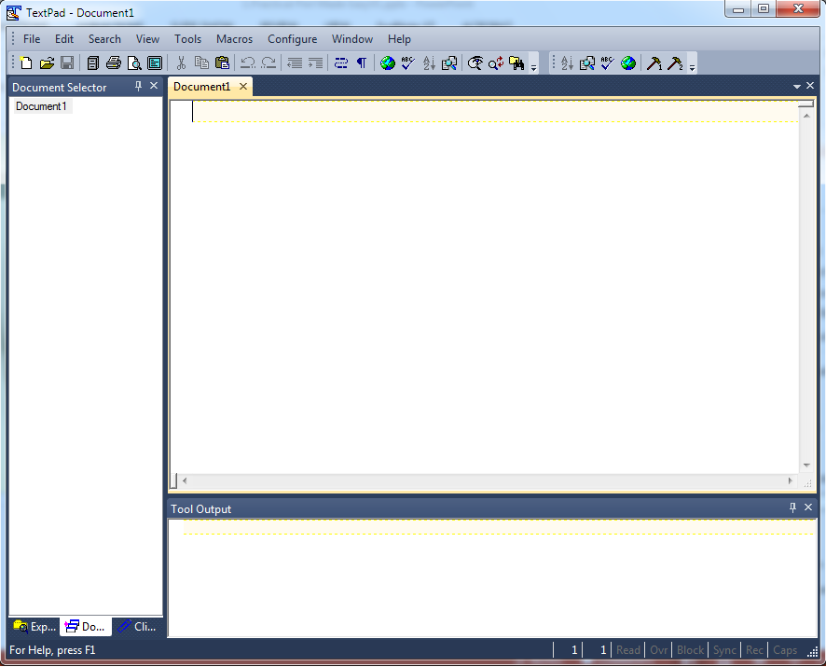
Textpad IDE for Perl on Windows
Document Selector
Coding Area
Output Area
TextPad is a powerful, general purpose editor for plain text files. Easy to use, with all the features a power user requires. It also has a customizable tools menu, where we can integrate the command line tools to run with the TextPad.

Slide 12
Configuring Textpad for executing Perl on Windows
Now that we have installed the Perl Interpreter and the Textpad, we got to configure Textpad to run Perl.
Double Click and Open the Textpad.
Go to the Configure menu and click on the Preferences.
In the Preferences Window click on the Tools option at the bottom.
Click on the Add pull down menu on the right side of Tools option and Select the Program… , then navigate to the “C:\Perl\bin\” and select perl.exe and click on Open and then Apply and Ok.

Slide 13
Components of Perl Script
Shebang line: Linux
Shebang line - Windows – not necessary
Path to Perl Interpreter
#!/usr/bin/perl
#!C:\Perl\bin\perl.exe
use strict;
use warnings;
use module-name;
#This is a program to understand the components
#of a Perl Script.
print “Practical Perl Made Easy\n”;
Helps to find typos in variable names
Helps to find errors in the code
Module Name (optional)
Comments
Ignored by Interpreter
Statements/Instructions
Statements end with semi colon.

Slide 14
How to execute Perl on Windows
Now your Textpad is configured for running Perl.
#!/usr/bin/perl
$n=100;
print "The prime numbers between 2 and $n are:\n";
for($i=3;$i<=$n;$i++)
{
$is_prime = 1;
for($j=2;$j<=sqrt($i);$j++){
if($i % $j == 0){
$is_prime = 0;
next;
}
}
if($is_prime == 1) {
print $i."\n";
}
}

Slide 15
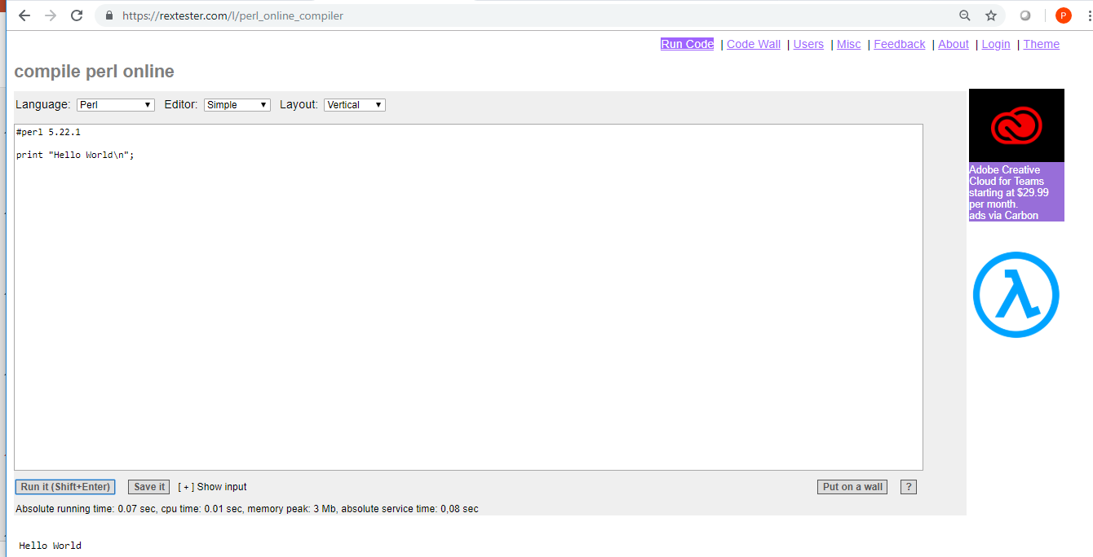
Practicing Perl online
https://rextester.com/l/perl_online_compiler

Slide 16
Motto
The Perl motto is 'There's More Than One Way To Do It', emphasizing both the flexibility of Perl and the fact that Perl is about getting the job done.
We can say that one Perl program is faster, or more efficient than another, but if both do the same thing, Perl isn't going to judge which one is 'better'. It also means that you don't need to know every last little detail about the language in order to do what you want with it. You'll probably be able to achieve a lot of the tasks you might want to use Perl for after completing this short training.
#!/usr/bin/perl -w
use strict;
my @array = (10, 20, 30, 40, 50);
my $n=@array;
for(my $i=0;$i<$n;$i++)
{
print "$array[$i]\n";
}
#!/usr/bin/perl -w
use strict;
my @array = (10, 20, 30, 40, 50);
foreach my $line(@array)
{
print "$line\n";
}

Slide 17
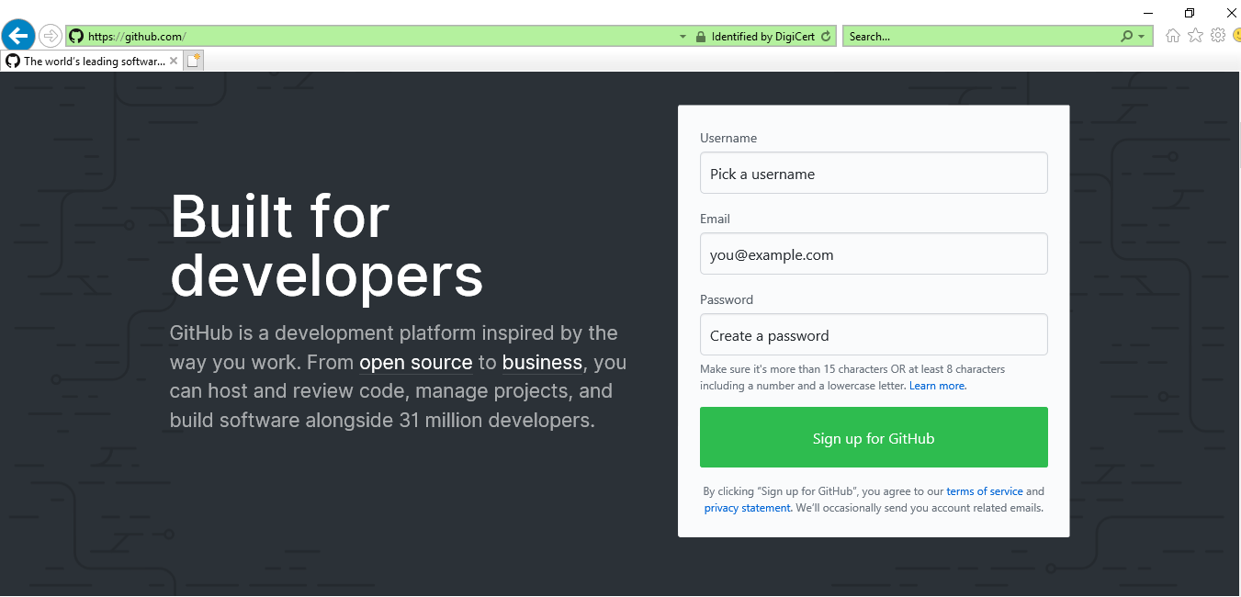
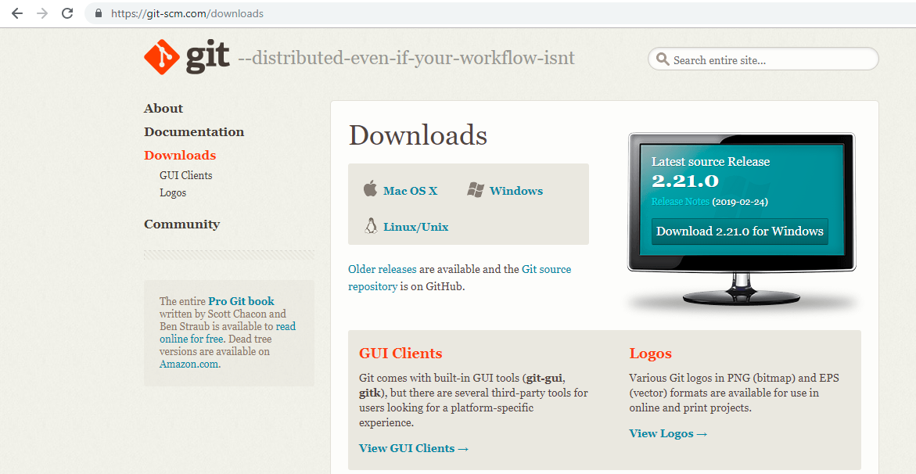
Git and its Installation
Git user registration
Download git for windows

Slide 18
Creating Repositories in Git & pushing your scripts
$ mkdir xxxxx
$ cd xxxxx
$ git config --global user.name prabhakarg-dm
$ git config --global user.email prabhakarg@decisionminds.com
$ git remote
$ git remote –v
(add files to directory)
$ git status
$ git add .
$ git commit -m Perl-Python-API
$ git push

Slide 19
Running Perl in git bash console
#!/usr/bin/perl
print "Enter the number till which you want to generate prime numbers";
$n=<STDIN>;
chomp($n);
print "The prime numbers between 2 and $n are:\n";
for($i=3;$i<=$n;$i++)
{
$is_prime = 1;
for($j=2;$j<=sqrt($i);$j++){
if($i % $j == 0){
$is_prime = 0;
next;
}
}
if($is_prime == 1) {
print $i."\n";
}
}
$ perl –v
$ perl –e ‘print “Perl Training\n”;’
$ perl prime.pl

Slide 20
Coming up in session 2
Data Types (scalars, arrays and hashes)
Operators (mathematical, relational, boolean)
Global and local variables
Conditional statements
Thank you

